Slide 1
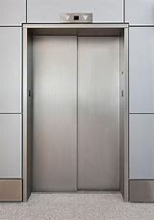
Elevator Instructions
As a precaution related to the recent cases of Coronavirus in the United States, please follow theses guidelines
This Elevator can only have 1 person at a time to provide appropriate Social Distancing

